Slide 1
Power System Security
The main factor in the operation of power system is to keep the system operating when components fail.
Example:
A generating unit may have to go off line because of failure of some auxiliary equipment.

Slide 2
Power System Security
Or because of a storm a Tr. line may be taken out of the system by automatic relaying.
In first case if we have sufficient spinning reserve then we can keep the system in operation without a too low drop in frequency.
In the second case if we had given a proper priority to line flow limits then with the help of ATC of Tr. lines system can be operated without load shedding.

Slide 3
Blackout

Slide 4
The techniques and systems used to keep the system running in a reliable manner are lumped under the title Power system security.
There are 3 major functions under power system security.

Slide 5
Major Functions of security
System Monitoring
Contingency Analysis
SCOPF

Slide 6
System Monitoring
Most important function among the three
It involves:
i) Measuring critical quantities like voltage current ,line flows, status of CB’s and switches of every substation.
ii) Also frequency, unit outputs and T/F tap positions
iii)Transmitting it to central station.

Slide 7
This huge information cannot be dealt by human to check the data for any abnormalities.
Hence digital computers are used for checking the data and producing alarm to the operators when voltage violations and overloads.

Slide 8
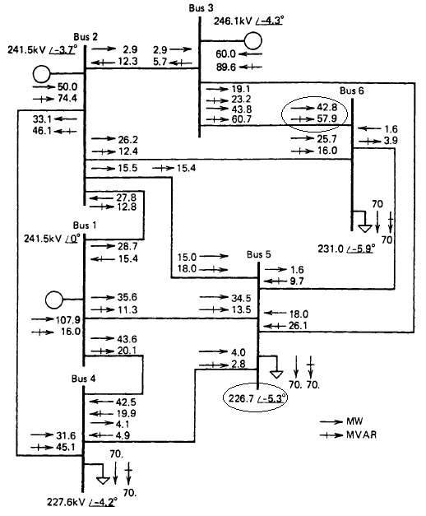
Contingency Analysis

Slide 9
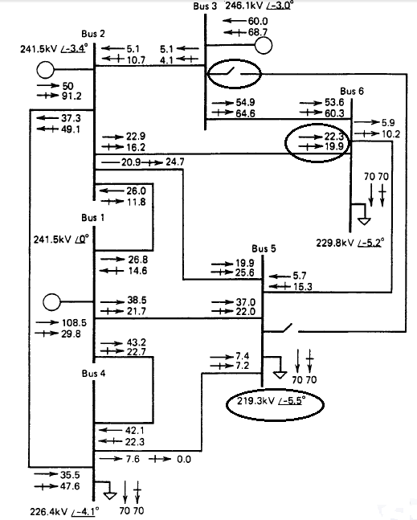
Contingency Analysis

Slide 10
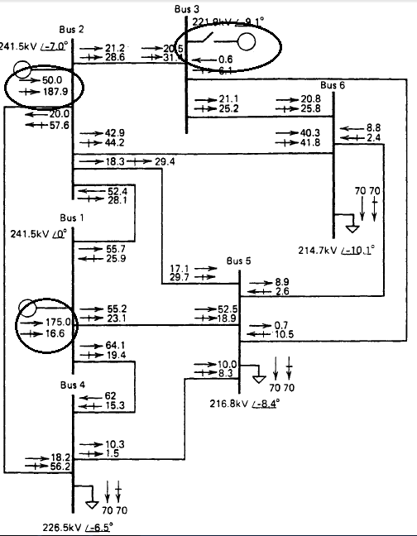
Contingency Analysis

Slide 11
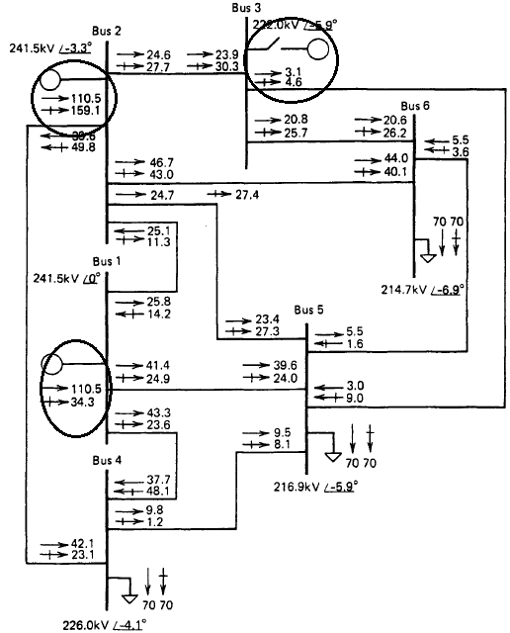
Contingency Analysis

Slide 12
SCOPF
Four Operating States
1. Optimal dispatch
2. Post contingency
3. Secure dispatch
4. Secure Post contingency.

Slide 13
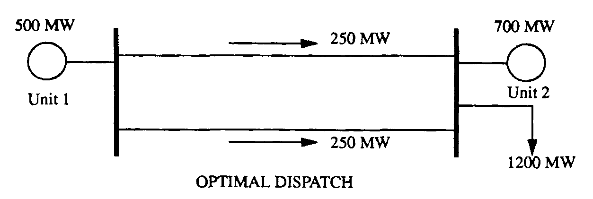
Example

Slide 14
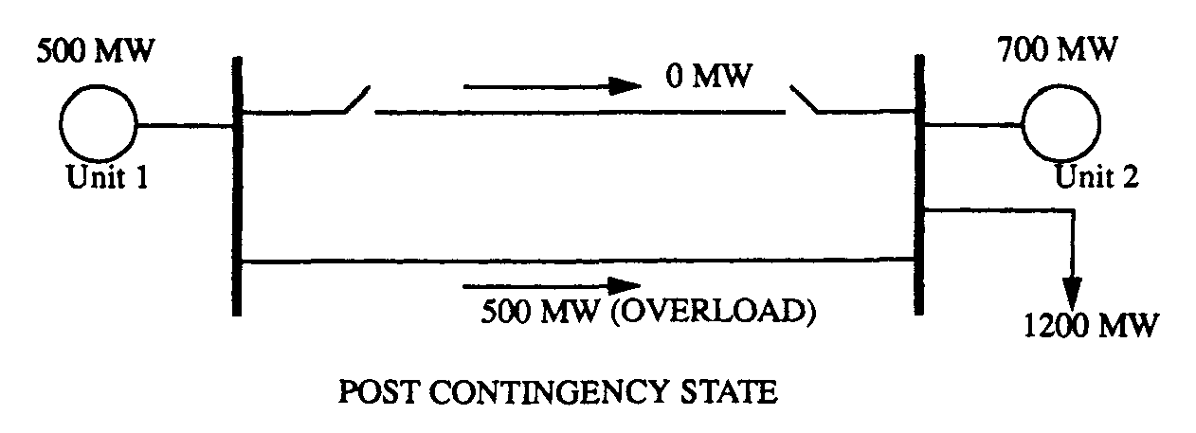

Slide 15
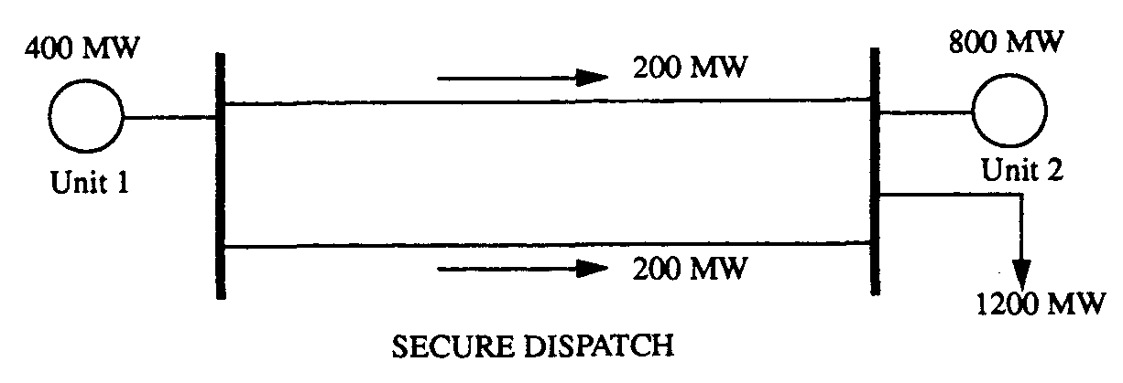

Slide 16
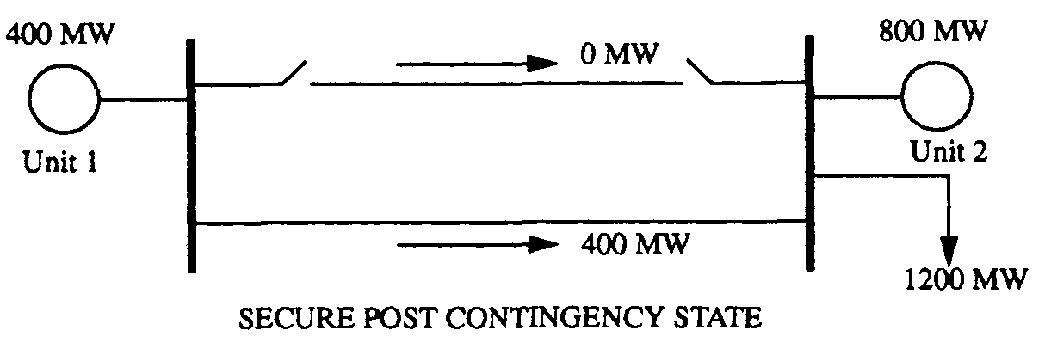

Slide 17
Factors Affecting security
Priorities of operating modern power system.
Reliability: Operate the system in such a way that power is delivered reliably.
Economics of operation: Operate the system most economically within in the constraints of reliability.

Slide 18
Factors Affecting Reliability
Adequate generation facility
Adequate transmission facility.
Practical problem can reduce the reliability: example: failure of equipment due to
internal problems
ii) external problems like lightning strikes and objects hitting Tr. Towers
iii) human errors in setting relays.

Slide 19
Factors Affecting Reliability
It will be most uneconomical to design a system with 100% reliability( no load shedding).
They are designed with acceptably small probability of dropping load.
They are designed to withstand all major failure events.
But this will not guarantee 100% reliability.

Slide 20
Economics of operation

Slide 21
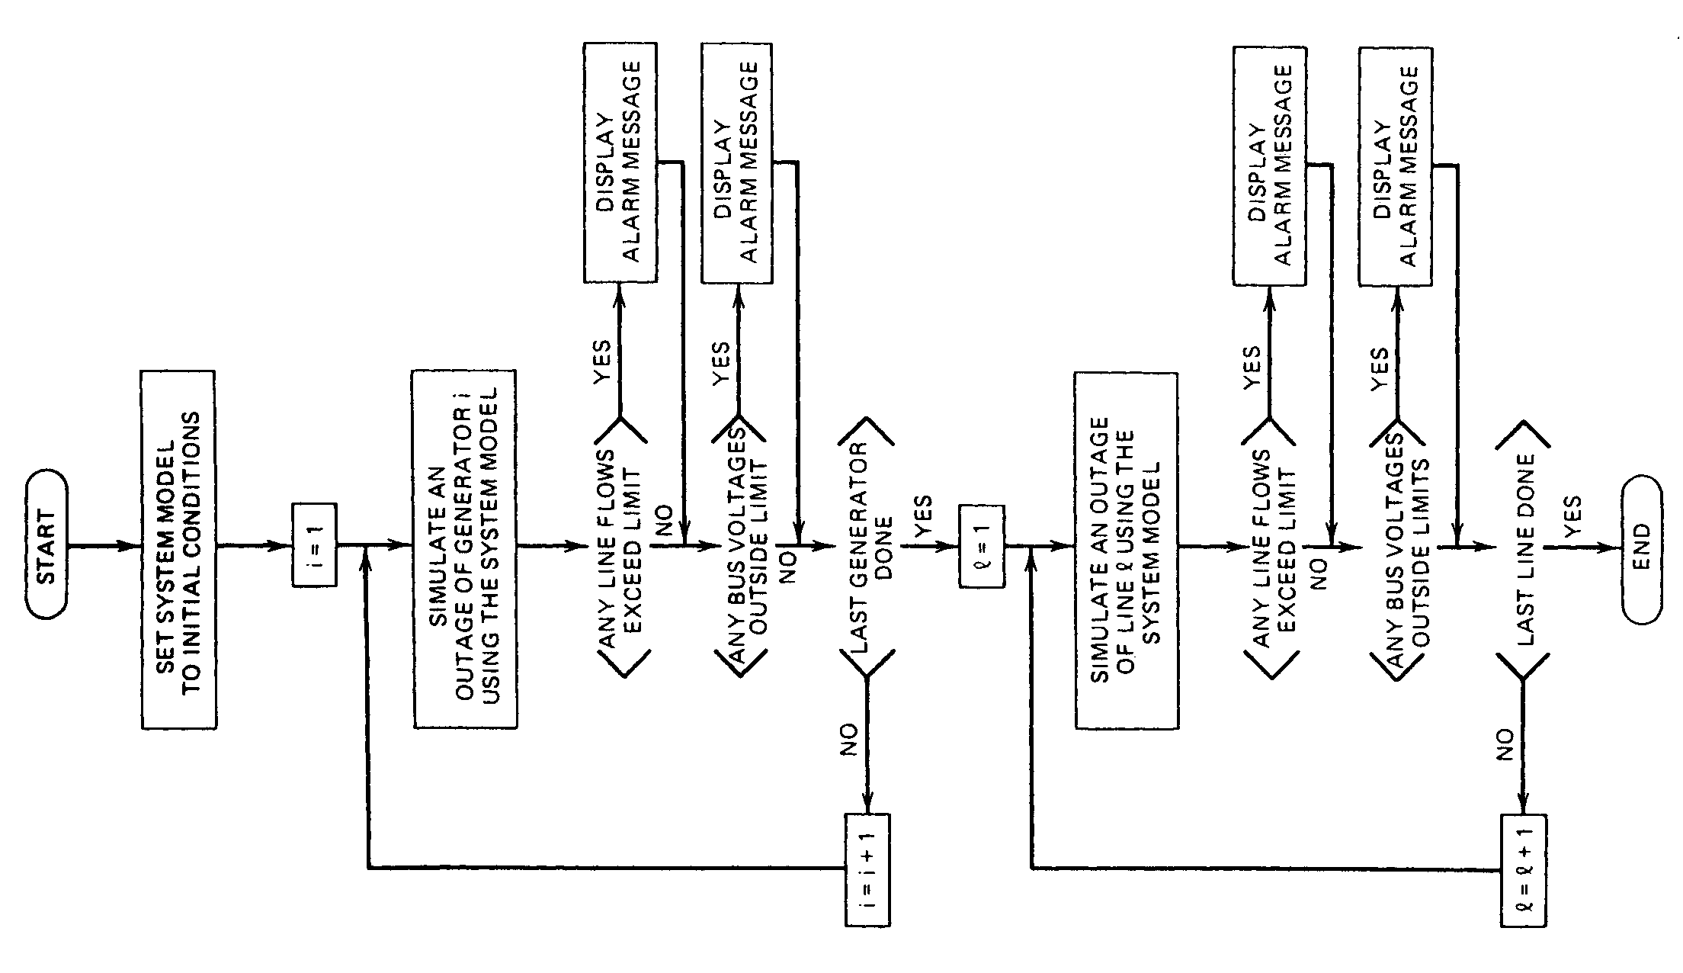

Slide 22
Contingency analysis using Linear sensitivity factors
It is the easiest way of calculating overloads.
It uses linear sensitivity factors( LSF).
These show changes in line flows for changes in generation.
The 2 types of LSF are
i) Generation shift factors(GSF)
ii) Line outage distribution factors(LODF)

Slide 23
Generation shift factors(GSF)
derivation of generation shift factor

Slide 24


Slide 25
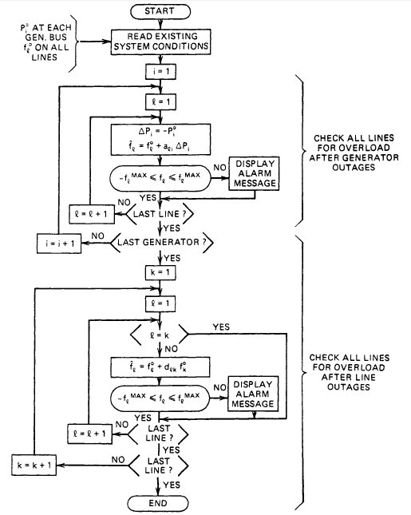
Contingency Analysis using Sensitivity Factors

Slide 26
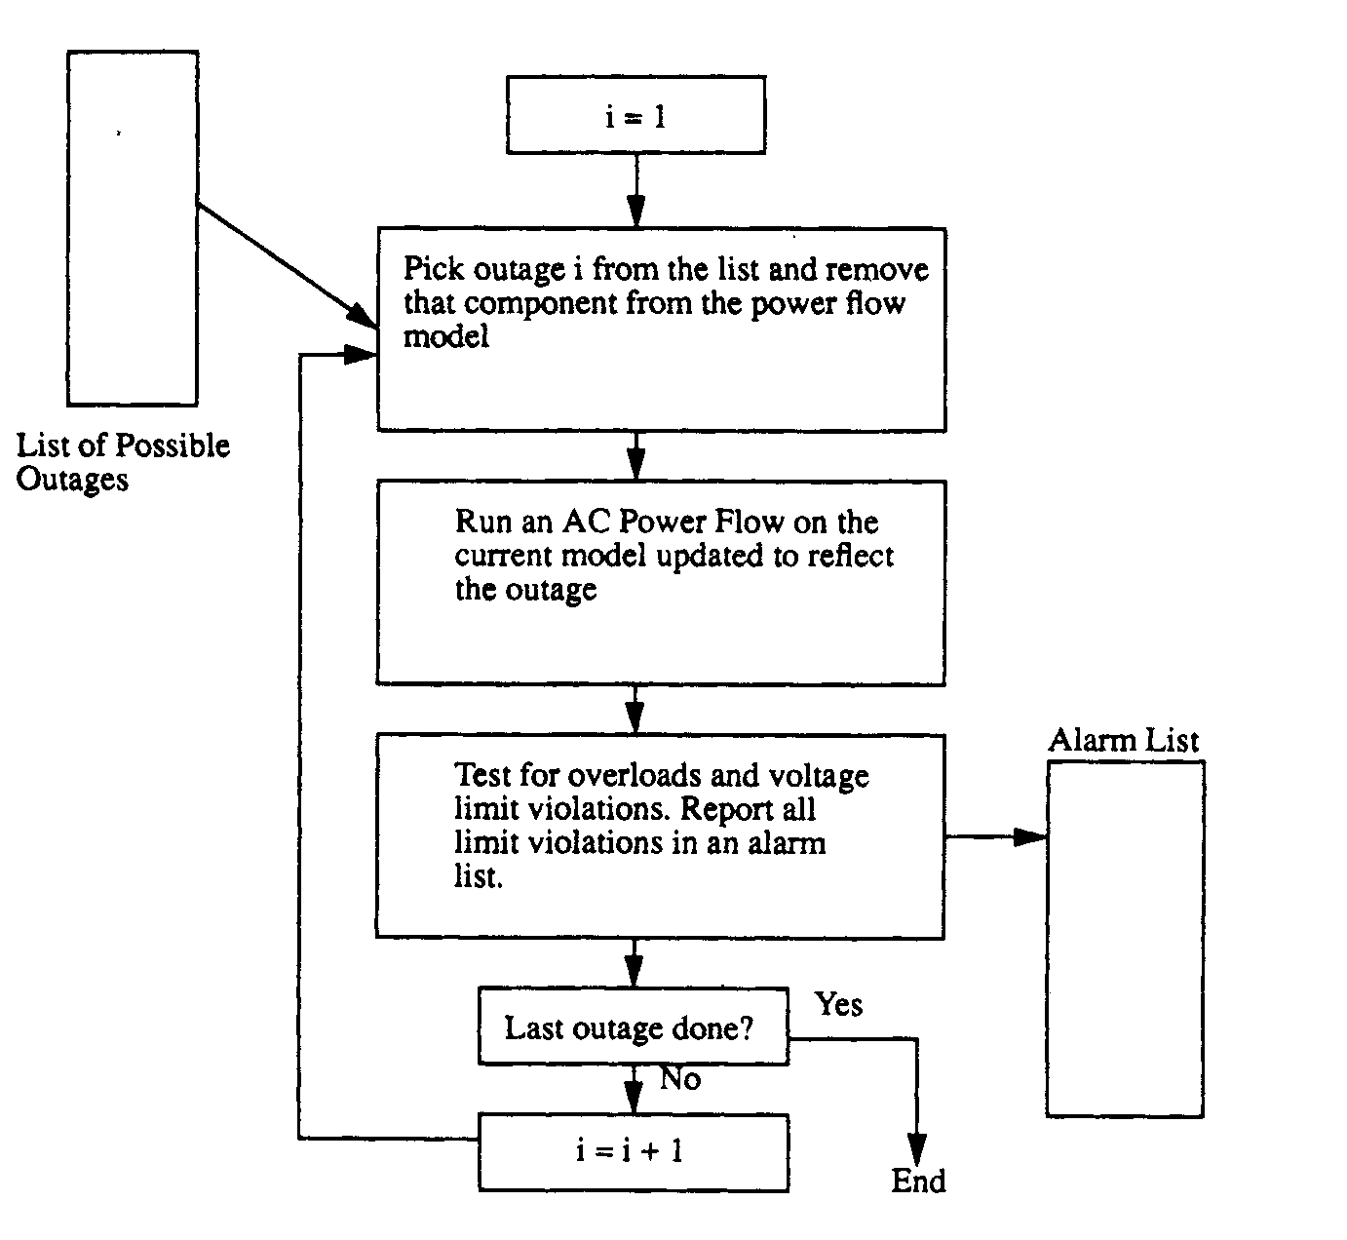
Contingency analysis using AC Power Flow method.

